Slide 1
COMP 55
Chapter 8

Slide 2
Admin
Weekly Status Reports
Now you’re just coding
You should be committing/coding 3 days out of the week.
Next Tuesday you will need to show something (I will just pull from github and run)

Slide 3
Agenda
Talk about the code I gave you
Team Time

Slide 4
We’re gonna go off topic
No questions
Alumni party
Notes:
I DJ’ed an alumni party this weekend, and it’s funny, because the majority of the people that go and dance at the party are like looking to find a relationship, rekindle stuff, but it’s funny because sometimes it falls flat on their face. Time and time again, I see people miss some of the basics, so I’ve developed four tips for you

Slide 5
Dating Tips (suggestions)
Your partner can become a better person when you are with them, but don’t change who they are on the inside
Notes:
From Ryan Scheiderer –
ryan scheiderer: ocp: open close principle. in terms of dating: you should be able to make your partner better, but not change who they are inside.
dry: don't repeat yourself, terms of dating: if you have to constantly repeat yourself, then something's wrong and you need to find a better way.
lsp: liskov sub principal, a sub-class should be able to replace it's superclass without major issues.
In terms of dating: you should make sure you look good in more than just one type of outfit/pair of clothes
srp: I don't remember this one.

Slide 6
Dating Tip #2
If you have to keep saying the same stuff over and over, they aren’t listening to you
Notes:
They’re not listening

Slide 7
Dating Tip #3
Wondering if they are the one? Ask…yourself, do you like their parents?

Slide 8
Dating Tip #4
SRP
Single & Roamer Principle
If they have been single for a long time, and haven’t been in a committed relationship, just think twice

Slide 9
Socrative
Notes:
If you had to explain the four principles and what they mean, how would you do it?
Make sure to say the principle first (on a newline) and then give an explanation for it afterwards, like these dating principles.

Slide 10
Different Teams
Work on this together
Notes:
Jack (floater or take Bhakti & Jamie)
Malvika, Jesse T, Keely, Nico
Lisa, Daniel H, Max, Jamie
Sahib, Maxine, Kyle, Bhakti
Brendan, Alex, Kadri, Candace
An, Ryan, Cynthia, Pranav
Kurt, Obaid, Jassae, Anthony
Jiaxiang, Jessie H, Shawn, Ali

Slide 11
Come up with the four principles
In addition to principle and description:
Come up with an example (in pseudocode at least) that VIOLATES the principle, and then show how you would fix it.

Slide 12
Aggregation/Composition
Notes:
Just the filled diamond vs not the filled diamond and it being part of the requirements is just like whatever, not a big deal. I don’t care as much about which you use or anything, I care more that you just use it instead.

Slide 13

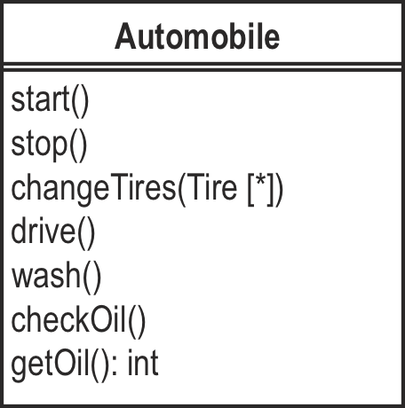
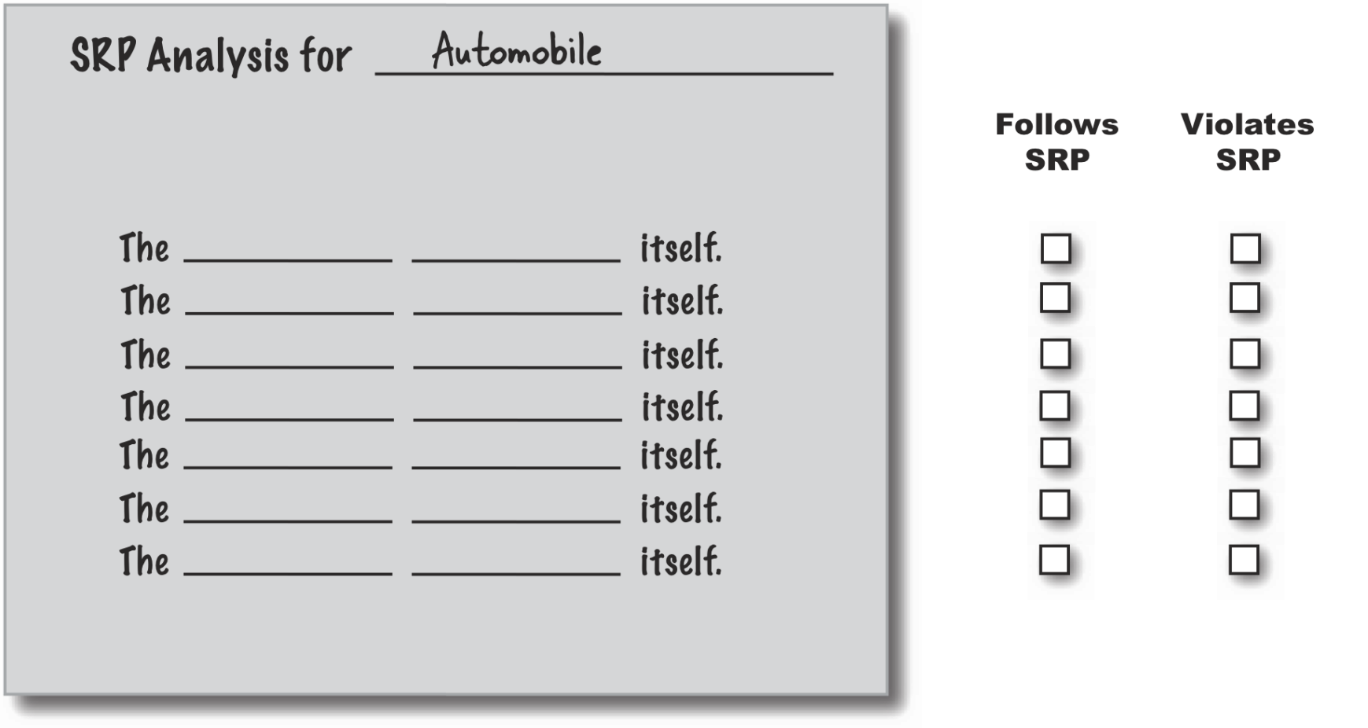
Applying SRP example
Notes:
Here’s the example from the text. Discuss the possibilities as to whether the method follows the SRP or not and check the appropriate box. Then compare your answers to the next slide.

Slide 14
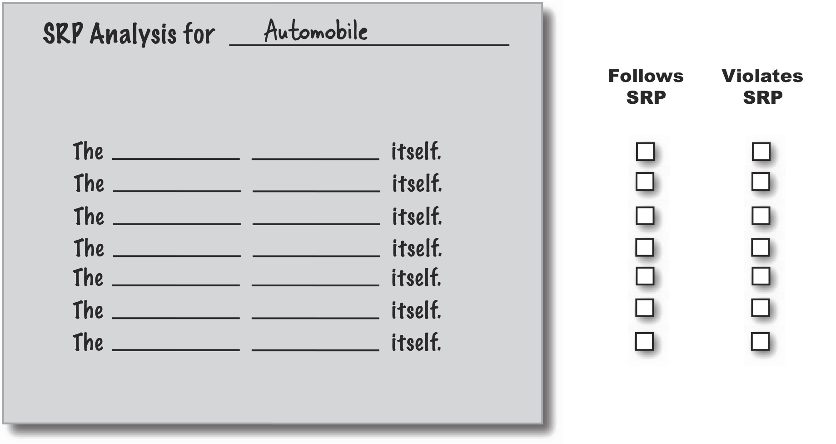
Applying SRP, one answer
Automobile
start[s]
✓
✓
Automobile
stop[s]
✓
Automobile
drive[s]
✓
✓
Automobile
changesTires
✓
Automobile
wash[es]
✓
Automobile
check[s] oil
Automobile
get[s] oil
Notes:
Here’s the answers we came up with. You might have different ones. For example, notice our interpretation of what get oil means? If you considered it to be refilling the oil, then your answer would be different. If you think of check oil as being what we considered get oil, then you would have made that a method that follows SRP. Now you might also have a better idea of why it’s important to document your understanding of the domain and system. If not, go back to Go, do not collect $200 and start over.

Slide 15
Another way to figure out cohesion

Slide 16

Measuring SRP with LCOM
Method | m1 | m2 | m3 | m4 | m5 | m6
Fields used | v1,v3,v5 | v2,v4 | v6 | v1,v7 | v5,v7 | v1,v3,v7
Notes:
LCOM is a lack of cohesion metric. There are many definitions for LCOM and we’ll use a simple one that is easy to calculate. Let’s say that you have a class, such as NotSRP shown here. It has six methods and seven fields. The table on top of the slide shows, for each method, the fields that are used (read or modified) by the method.
Our LCOM calculation takes the fields used by each methods and partitions them, and their methods into equivalent classes. The number of equivalence classes is the value of the LCOM metric. A value of one means that there is high cohesion that can’t be improved upon. Values greater than one mean that you may be violating the SRP. Let’s look at how we build the equivalence classes for this.

Slide 17
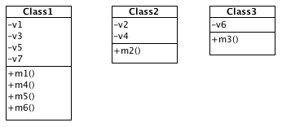
Computing LCOM
Step | Field Equivalences | Method Equivalences
1 | {v1,v3,v5} | {m1}
2 | {v1,v3,v5}, {v2,v4} | {m1}, {m2}
3 | {v1,v3,v5}, {v2,v4}, {v6} | {m1}, {m2}, {m3}
4 | {v1,v3,v5, v7}, {v2,v4}, {v6} | {m1, m4}, {m2}, {m3}
5 | {v1,v3,v5, v7}, {v2,v4}, {v6} | {m1, m4, m5}, {m2}, {m3}
6 | {v1,v3,v5, v7}, {v2,v4}, {v6} | {m1, m4, m5, m6}, {m2}, {m3}
Notes:
Here, we look at each method in the original class and create our sets based upon the fields used in each method. The table above shows how we proceed. In the first step we look at method m1 and see that there are three fields that it uses. Step 2 looks at m2 and we find that it uses fields v2 and v4. These are not included in the set of fields that we got from step 1 so we add a new set to our field equivalences and method equivalences. Step 3 examines m3 and we find that we must add another set. Steps 4-6 do not create any new field equivalences but step 4 does add v7 to the first set of fields and m4 to the method set containing m1. The remaining steps add no new fields but add methods to our first set of methods. When we’re done we have three equivalence sets indicating that the original class can be decomposed into three classes. There are no dependencies or other associations between the classes (at least from their internal structure). The classes are shown in the class diagram. LCOM for each of these classes is one.
There are many software tools that will calculate LCOM automatically. You need to make sure you understand the algorithm they use to calculate the metric and how to interpret it. Our calculation is simple and intuitive. LCOM was developed by Chidamber and Kemmerer in a paper from the ‘90s.
If you’ve got some idle time, try constructing equivalence sets by using a graph. Each vertex in the graph corresponds to a field in the original class. When two fields are used by the same method, their vertices are connected. When you’re done, the number of disconnected subgraphs is the value of LCOM.

Slide 18
Team Time
I will be explaining the code I gave you

Slide 19
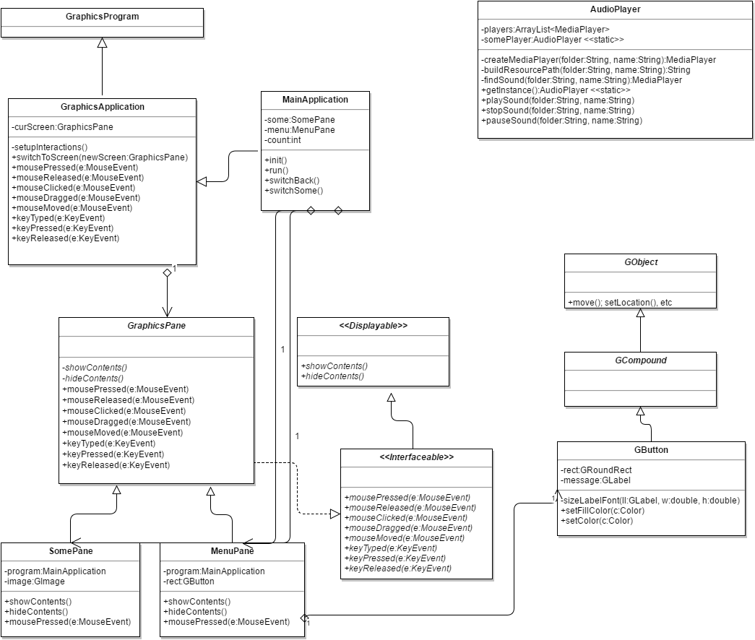

Slide 20
